Slide 1
第2章：隐马氏模型(HMM) 及其应用
Markov Model
Page rank算法和Markov Model
Hidden Markov Model (HMM)
HMM的理论基础
HMM的应用

Slide 2
Part I
Markov Model

Slide 3
食堂就餐人数问题 (I)
某大学有三个食堂A、B、C。调查显示：在食堂A就餐的人中p_{aa}部分仍然回到食堂A，有p_{ab}部分选择食堂B，p_{ac}部分选择食堂C；在食堂B就餐的人中p_{bb}部分仍然回到食堂B，有p_{ba}部分选择食堂A，p_{bc}部分选择食堂C；在食堂C就餐的人中p_{cc}部分仍然回到食堂C，有p_{ca}部分选择食堂A，p_{cb}部分选择食堂B；
请估计在食堂A、B、C的就餐人数。

Slide 4
食堂就餐人数问题 (II)
P_{ca}
P_{ba}
P_{cb}
P_{aa}
A
B
C
P_{cc}
P_{ab}
P_{bc}
P_{ac}

Slide 5
食堂就餐人数问题 (III)
令A_{n}为第n天在食堂A就餐的人数比例
令B_{n}为第n天在食堂B就餐的人数比例
令C_{n}为第n天在食堂C就餐的人数比例

Slide 6
不动点问题 (I)
问题：极限是否存在？若存在，

Slide 7
不动点问题(II)
若初值为π₀=(A₀,B₀,C₀)，并令P为上式中的矩阵，则
若π=(1/3,1/3,1/3)，P由下面的矩阵给出，我们可以具体计算(A_{n},B_{n},C_{n})

Slide 8
不动点问题(III)
n | A_{n} | B_{n} | C_{n} | n | A_{n} | B_{n} | C_{n}
1 | 0.4500 | 0.2833 | 0.2667 | 11 | 0.5553 | 0.1947 | 0.2500
2 | 0.5008 | 0.2458 | 0.2533 | 12 | 0.5554 | 0.1946 | 0.2500
3 | 0.5261 | 0.2232 | 0.2507 | 13 | 0.5555 | 0.1945 | 0.2500
4 | 0.5395 | 0.2104 | 0.2501 | 14 | 0.5555 | 0.1945 | 0.2500
5 | 0.5468 | 0.2032 | 0.2500 | 15 | 0.5555 | 0.1945 | 0.2500
6 | 0.5507 | 0.1993 | 0.2500 | 16 | 0.5555 | 0.1945 | 0.2500
7 | 0.5529 | 0.1971 | 0.2500 | 17 | 0.5555 | 0.1945 | 0.2500
8 | 0.5541 | 0.1959 | 0.2500 | 18 | 0.5555 | 0.1945 | 0.2500
9 | 0.5548 | 0.1952 | 0.2500 | 19 | 0.5555 | 0.1945 | 0.2500
10 | 0.5551 | 0.1949 | 0.2500 | 20 | 0.5555 | 0.1945 | 0.2500

Slide 9
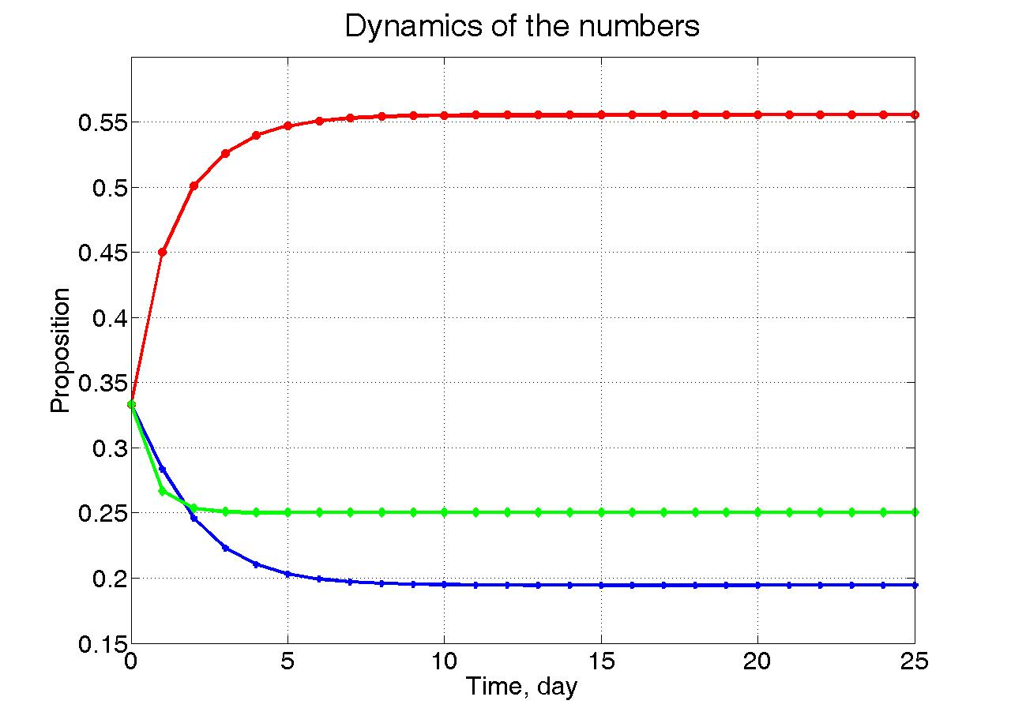
不动点问题(IV)

Slide 10
换起点π=(0.8,0.1,0.1)
n | A_{n} | B_{n} | C_{n} | n | A_{n} | B_{n} | C_{n}
1 | 0.66 | 0.12 | 0.22 | 11 | 0.5558 | 0.1942 | 0.25
2 | 0.607 | 0.149 | 0.244 | 12 | 0.5557 | 0.1943 | 0.25
3 | 0.5827 | 0.1686 | 0.2488 | 13 | 0.5556 | 0.1944 | 0.25
4 | 0.5702 | 0.1800 | 0.2498 | 14 | 0.5556 | 0.1944 | 0.25
5 | 0.5636 | 0.1865 | 0.2500 | 15 | 0.5556 | 0.1944 | 0.25
6 | 0.5600 | 0.1901 | 0.2500 | 16 | 0.5556 | 0.1944 | 0.25
7 | 0.5580 | 0.1920 | 0.2500 | 17 | 0.5556 | 0.1944 | 0.25
8 | 0.5569 | 0.1931 | 0.2500 | 18 | 0.5556 | 0.1944 | 0.25
9 | 0.5563 | 0.1937 | 0.2500 | 19 | 0.5556 | 0.1944 | 0.25
10 | 0.5560 | 0.1940 | 0.25 | 20 | 0.5556 | 0.1944 | 0.25
不动点还和前面的一样！

Slide 11
问题的特征
每一步活动只与当前处在什么“状态”有关，与过去的“状态”没有关系。
矩阵P特殊性：每行和为1，表示下一个时刻的状态必须在A、B、C中之一。
马尔可夫链模型，简称马氏链。

Slide 12
离散时间随机过程
对于离散的时间 t=0, 1, 2, 3, ☹ 的每一个 t 对应一个随机变量ξ_{t}(ω)，我们把ξ={ξ₀, ξ₁, ☹, ξ_{n}, ☹}这样一个随机变量的序列叫做离散时间的随机过程。
所有ξ_{t}(ω) (t=0, 1, 2, 3, ☹ ) 具有公共的取值集合, 我们把此集合叫做状态空间，记为 S 。

Slide 13
离散时间随机过程
对于一个固定的ω, ξ(ω)={ξ₀(ω), ξ₁(ω), ☹, ξ_{n}(ω), ☹} 就是一个状态的序列, 称为该随机过程的一条轨道，我们把 ξ_{t}(ω) 的取值叫做该条轨道在时间 t 的状态。
的联合分布称为 ξ 的一个有限维分布, 我们用 ξ 的全部有限维分布刻画它的统计特性.

Slide 14
马氏(Markov)链
随机过程 称为有限状态马氏链， 若 只有有限个取值且满足
记之为
矩阵 称为从n出发的k步转移概率矩阵

Slide 15
时齐马氏链
如果马氏链的转移矩阵与出发时刻无关，即 则称此马氏链是时齐的。
这时将 简单地记为
通常不特别说明, 马氏链就指时齐马氏链。
前面的食堂问题就是一个1步时齐马氏链。

Slide 16
高阶马氏过程
若一个随机过程满足：
也就是说随机过程下一时间的发展只和包括当前时间在内的最近的k个时间的状态有关 而和这k个时间之前的历史没有关系, (其中k=0, 1, 2, ☹) ，我们把这样的随机过程叫做k阶马氏链。

Slide 17
零(1)阶马氏过程
显然 零阶马氏链就是说下一时间的发展和当前状态及已有历史都独立， 也就是相互独立的随机序列 (过程)。
1-阶马氏链就是前面的马氏链.

Slide 18
关于名称的一点说明
参考书中，看到马氏链(过程)的时候要根据上下文进行判断。有的时候是指普遍的马氏链(包括高阶、一阶、零阶)，有时候特指一阶马氏链。
在大多数情况下，如不特别说明，通常是特指一阶时齐的马氏链。
如果将一个 k-阶马氏链的相邻 k 个时间的状态合为一个新的状态: 则 {y_{n}} 是一个 1-阶马氏链。

Slide 19
转移概率矩阵性质
其中第三个方程称之为C－K方程

Slide 20
时齐马氏链性质 (I)
时齐马氏链由转移概率矩阵和初分布完全确定，设转移概率矩阵为P=(p_{ij})，初始分布： ，则

Slide 21
时齐马氏链性质 (II)
若记
即所谓绝对概率，则：

Slide 22
马氏链的不变分布
状态空间S上的一个概率分布称为转移概率矩阵P的不变概率分布(简称不变分布)，如果
一般来说，不变分布未必存在。若不变分布存在且唯一(记为π)，则它是以下代数方程组的唯一非负解。

Slide 23
概念 ：可达、互通、不可约
可达：状态i称为可达状态j, 如果存在一个指标序列 使得
用转移概率矩阵来刻画 i可达 j:
互通： 状态i可达状态j，而且状态j可达状态i.
不可约：如果所有状态之间是互通的.

Slide 24
概念：常返
常返性：马氏链 状态y称为常返的，如果概率为1地发生如下事件：从y出发的状态，有限时间内离开状态y，此后又必到达y，☹， 如此无限重复。

Slide 25
概念：周期
从某个状态i出发, 经过n步回到状态i的情形。为此定义集合
这个集合的最大公约数称之为状态i的周期T。
若T>1称状态i是周期的；若T=1,称状态i为非周期的。

Slide 26
Example
状态1,2,3的周期为2
1-p
1-p
1-p
1
0
1
2
3
4
1
p
p
p

Slide 27
马氏链的遍历极限(I)
若马氏链 的状态空间S为有限集(不妨设S={1,2,☹, N})，且ξ(转移矩阵为P)是一个互通常返马氏链，则它存在唯一的不变概率分布 并使得

Slide 28
马氏链的遍历极限(II)
若马氏链 的状态空间S为有限集(不妨设S={1,2,☹, N})，且转移矩阵矩阵的每个元素为正，则它存在唯一不变概率分布 满足如下(指数)遍历性

Slide 29
马氏链的遍历极限(III)
令 是 中首次出现状态 i 的时间。那么 就是一个平均返回(状态i)时间。有结论如下
对于互通常返马氏链
其中不变分布为

Slide 30
Part II
Page Rank算法和Markov Model

Slide 31
Page Rank
Basic idea of Page Rank.
Calculation of Page Rank.
Page Rank and Markov chain
Modified from http://www.eee.bham.ac.uk/russellm/ee3j2/Slides%202009/OHP10%20Page%20Rank%202009.pdf

Slide 32
Basic Idea of Page Rank
Suppose that:
Page d₁ contains hyperlinks to 10 pages;
Page d₂ just has a single link to page d₃
The contribution of d₂ to pr(d₃) should be greater than the contribution of d₁
The simplest solution is to allocate a weight of w_{de} =1/L(d) to the hyperlink from document d to document e, where L(d) is the number of hyperlinks from d.
Modified from http://www.eee.bham.ac.uk/russellm/ee3j2/Slides%202009/OHP10%20Page%20Rank%202009.pdf

Slide 33
Random Surfer Model
w_{de} can be thought of as the probability of following the link to page e if the user is on page d.
The case where w_{de} = 1/L(d) corresponds to the random surfer model: on any page the random surfer is equally likely to choose any of the available links.

Slide 34
Simplified Page Rank Calculation
Once pr(d) is accepted as a measure of the importance of d there is a natural consequence;
In the calculation of pr(d), a hyperlink from a page d₁ to d should count for more than a hyperlink from page d₂ to d if pr(d₁) > pr(d₂)
This motivates:
where L(d) is the set of pages which link to page d.
Modified from http://www.eee.bham.ac.uk/russellm/ee3j2/Slides%202009/OHP10%20Page%20Rank%202009.pdf

Slide 35
Simplified Page Rank Calculation
pr=0.1
pr=0.35
1/3
1/3
pr(d)
1
1/2
1
1/3
pr=0.15
pr=0.25
1/2
Modified from http://www.eee.bham.ac.uk/russellm/ee3j2/Slides%202009/OHP10%20Page%20Rank%202009.pdf

Slide 36
Simplified Page Rank Calculation
Change pr(d) will change the page ranks of other pages, which in turn change pr(d);
In other words, the definition of page rank is recursive,
Modified from http://www.eee.bham.ac.uk/russellm/ee3j2/Slides%202009/OHP10%20Page%20Rank%202009.pdf

Slide 37
Markov Chain Interpretation
Let
Notice that each row of W sums to 1.
Modified from http://www.eee.bham.ac.uk/russellm/ee3j2/Slides%202009/OHP10%20Page%20Rank%202009.pdf

Slide 38
Markov Chain Interpretation
If the system converges, then pr=W^{T} pr.
pr is the invariant distribution of the Markov chain.
In other word, pr is an eigenvector of W^{T}.
Modified from http://www.eee.bham.ac.uk/russellm/ee3j2/Slides%202009/OHP10%20Page%20Rank%202009.pdf

Slide 39
Damping Factor
It represents the change that user stopping clicking links and get bored with the current page and then request another random page.
If the damping factor is 85% then there is assumed to be about a 15% chance that a typical users won't follow any links on the page and instead navigate to a new random URL
Modified from http://www.eee.bham.ac.uk/russellm/ee3j2/Slides%202009/OHP10%20Page%20Rank%202009.pdf
Notes:
重新打开一个网页，这个网页上有包含有全部的Link

Slide 40
Page Rank
Taking into account the damping factor
DF
……
1
2
3
n-1
n
Modified from http://www.eee.bham.ac.uk/russellm/ee3j2/Slides%202009/OHP10%20Page%20Rank%202009.pdf

Slide 41
Part III
Hidden Markov Model

Slide 42
Hidden Markov Models - HMM
Hidden states
X₁
X₂
X_{i}
X_{T-1}
X_{T}
Y₁
Y₂
Y_{i}
Y_{T-1}
Y_{T}
Observed data

Slide 43
HMM－韦小宝的骰子
两种骰子，开始以2/5的概率出千。
正常A：以1/6的概率出现每个点
不正常B：5,6出现概率为3/10,其它为1/10
出千的随机规律
0.2
0.9
0.8
B
A
0.1

Slide 44
HMM例1－韦小宝的骰子
观测到其一次投掷结果
问题：请判断韦小宝什么时候出千了？

Slide 45
隐马氏模型的数学模型
隐过程为X={X₁,☹,X_{T}}
观察过程为Y={Y₁,☹,Y_{T}}
模型参数λ = { π , A，B }
初始分布π=(π_{i} ) , π_{i}=P{X₁=i}
转移矩阵A= (a_{ij} ), a_{ij} = P(X_{n+1}=j | X_{n}= i)
给定某个时间的隐状态的条件下, 观测的分布矩阵B=(b_{il} ) , b_{il} = P(Y_{n}=l | X_{n}= i) 。

Slide 46
隐马氏模型的数学问题
识别问题－ 已知若干个隐马氏模型及其参数，对一个观测样本，决定它来自哪一个模型 。
解码问题－由观测样本得到隐状态；
学习问题－由观测样本得到参数组 λ ；

Slide 47
Part IV
隐马氏模型(HMM)理论

Slide 48
识别问题
在已知若干个模型及其参数的情况下,识别问题就是一个对于给定样本进行 Bayesian 判决的问题。
判决步骤:
根据参数求出在每一个模型中, 出现给定样本的概率P(Y | λ ), 归一化就得到给定样本来自每个模型的概率 P ( λ | Y) 。
利用 Bayesian 原理， 就可以得到最好模型猜测。

Slide 49
观测序列的概率计算
枚举复杂度 2TNT
多项式复杂度算法：前传算法和后传算法

Slide 50
前传概率

Slide 51
前传算法 (Forward Algorithm)
初始化
迭代
结果

Slide 52
后传概率

Slide 53
后传算法(Backward Algorithm)
初始化
迭代
结果

Slide 54
解码问题(I)
问题： 给定观测序列 如何给出隐状态序列
单点最优
路径最优指：对任意的 有

Slide 55
解码问题(II)
由Bayesian公式有
又由于序列 Y 给定, 问题等价于找最优的X⁰使联合概率 最大。

Slide 56
最优单点确定

Slide 57
Viterbi算法(I)
算法的思想动态规划的递推算法。
递推变量为
我们有递推公式
以ψ_{t}(i)记录t时刻时使δ_{t}(j)a_{ji}最大的状态j。

Slide 58
Viterbi算法(II)
初始化
迭代

Slide 59
Viterbi算法(III)
终止
后推

Slide 60
Viterbi算法实例(I)
转移概率以及初概率
条件概率(Emission Probability)
 | A | B
A | 0.8 | 0.2
B | 0.1 | 0.9
初概率 | 0.6 | 0.4
 | V₁ | V₂ | V₃ | V₄ | V₅ | V₆
A | 1/6 | 1/6 | 1/6 | 1/6 | 1/6 | 1/6
B | 0.1 | 0.1 | 0.1 | 0.1 | 0.3 | 0.3

Slide 61
Viterbi算法实例(II)
 | y_{t} | δ_{t}(A) | ψ_{t}(A) | δ_{t}(B) | ψ_{t}(B)
t=1 | 1 | 1.000x10⁻¹ | - | 4.000x10⁻² | -
t=2 | 3 | 1.333x10⁻² | A | 3.600x10⁻³ | B
t=3 | 4 | 1.778x10⁻³ | A | 3.240x10⁻⁴ | B
t=4 | 5 | 3.370x10⁻⁴ | A | 1.067x10⁻⁴ | A
t=5 | 5 | 3.161x10⁻⁴ | A | 2.880x10⁻⁵ | B
t=6 | 6 | 4.214x10⁻⁶ | A | 7.776x10⁻⁶ | B
t=7 | 6 | 5.619x10⁻⁷ | A | 2.100x10⁻⁶ | B
t=8 | 3 | 7.492x10⁻⁸ | A | 1.890x10⁻⁷ | B
t=9 | 2 | 9.989x10⁻⁹ | A | 1.701x10⁻⁸ | B
t=10 | 6 | 1.322x10⁻⁹ | A | 4.592x10⁻⁹ | B

Slide 62
Viterbi算法实例(III)
观测序列为：
1 3 4 5 5 6 6 3 2 6
A
A
A
A
A
A
A
A
A
A
B
B
B
B
B
B
B
B
B
B
解码出来的状态序列为：
A A A B B B B B B B

Slide 63
HMM学习问题
学习问题:
就是由观测估计模型参数.
学习的两种情况：
观测链相应的状态链已知 ;
观测链相应的状态链未知 。

Slide 64
学习原则
极大似然估计(MLE)
状态链已知时
状态链未知时

Slide 65
状态链已知时的MLE

Slide 66
简单优化问题

Slide 67
参数估计(状态已知)
把从状态 i 到转移为状态 j 的频数记为 可估计转移概率 为
同样记状态 i 下观察到符号 s 的频数记为 则可估计 为

Slide 68
参数估计评价
隐Markov模型的状态链要有充分长的样本(大数定律，以频率代替概率)。
不幸的是状态链往往并不知道, 而只是可以得到估计, 不修正地使用频率估计会增加误差, 且这种估计不稳健。

Slide 69
参数估计的EM思想
当状态链未知时，由于似然函数的计算中包含了对所有可能的状态链的求和，计算过大，在实际中是不可能被采用的．为此，人们采取折衷的方案，构造一个递推算法，使之能相当合理地给出模型参数的粗略估计．
其核心思想是：在当前参数下，用期望值当成频数“数数”，并用的“频率”估计概率。这实际上是一种EM迭代算法思想。

Slide 70
EM算法
实际上是 E (期望) 与 M (最大化) 两个步骤合起来构成的算法，称为EM算法．
EM算法是针对测量数据不完全时, 求参数的最大似然估计的统计方法。
HMM 的模型参数的估计, 是EM算法的一个最常见且极有用的一种典型例子．

Slide 71
EM算法基本框架
观测数据Y
缺失数据 X
完全数据 Z=(Y, X).
E-Step (取期望).
M-step (取极大).
Notes:
We use EM algorithm to solve this MLE problem.
Given the observation data, and missing data, we can construct complete data.
EM algorithm contains two step.
In E-step, we compute the expectation of complete data based on observation and current
Estimation of parameters.
In M-Step, we use the esitimated complete data to maximize the parameters.

Slide 72
期望频数(状态未知)

Slide 73
期望频数(状态未知)

Slide 74
Baum-Welch公式

Slide 75
Baum-Welch公式的推导(1)
我们定义一个描述模型“趋势”的量，以衡量参数估计前后的概率分布的差异。相对熵是最好的选择

Slide 76
Baum-Welch公式的推导(2)
说明只要依据Q函数增大来更新参数，就能够使得似然函数朝变大的方向改进，而且一个观测Y对应了一次改进。

Slide 77
Baum-Welch公式的推导(3)
于是要想得到参数修改的递推公式, 只要把模型λ_{m}修改为更好的模型λ_{m+1} , 即只需将它取得使下式成立，

Slide 78
Baum-Welch公式的推导(4)
写出Q函数的表达式，我们有

Slide 79
Baum-Welch公式的推导(5)
对每个变量可以分别取最大值。

Slide 80
初概率的重估计

Slide 81
转移概率重估计

Slide 82
观测概率重估计

Slide 83
几点说明
更详细的内容可参见《应用随机过程》 第十章 HMM.
在上面所述的算法中，初始值 λ₀ 的设置会直接影响到估计的好坏．为此，常用的一种方法是, 根据先验知识设置一条较长的 “标准虚拟” 状态链, 再用前面讲的已知观测链相应的状态链的情况下参数估计的方法, 得到一个对参数的粗估计，并以它作为 λ₀ 的取值。

Slide 84
Part V
隐马氏模型应用

Slide 85
应用1：基因序列CpG岛识别
本部分ppt修改自网上资料
http//people.brandeis.edu/~moshep/Projects
/ProjectPresentations2003_2/HMM/CpG_Islands_HMM_final.ppt

Slide 86
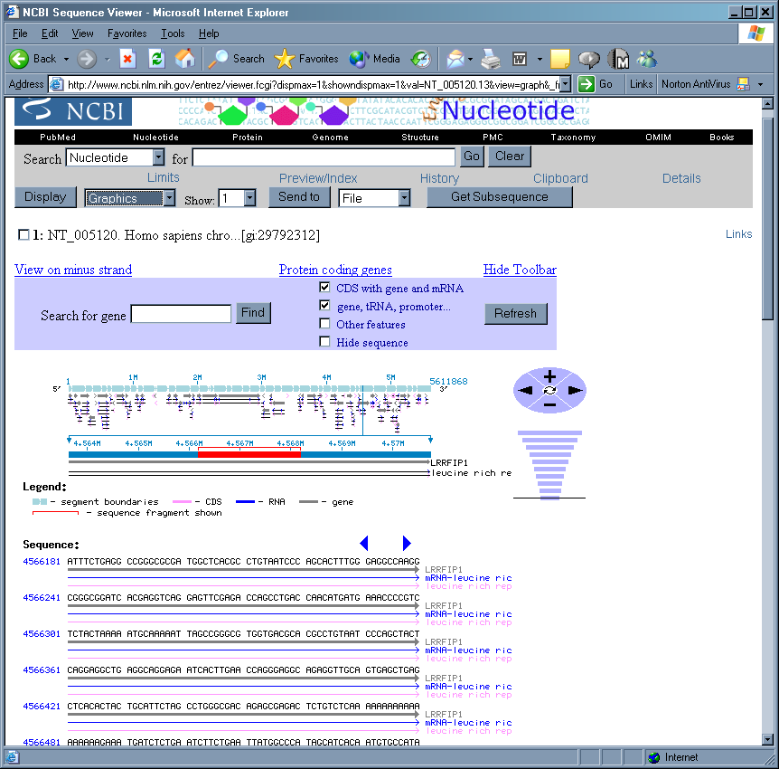
什么是CpG岛？
CG-poor regions: P(CG) ~ 0.07!
CG-rich region: P(CG) ~ 0.25
……
Gene coding region
Promoter region

Slide 87
CpG岛
Away from gene regions:
The C in CG pairs is usually methylated
Methylation inhibits gene transcription
These CGs tend to mutate to TG
Near promoter and coding regions:
Methylation is suppressed:
CGs remain CGs
Makes transcription easier!

Slide 88
CpG岛的生物学意义
CpG-rich regions are associated with genes which are frequently transcribed.
Helps to understand gene expression related to location in genome.

Slide 89
HMM对于CpG岛识别的意义
Q: Why an HMM?
It can answer the questions:
Short sequence: does it come from a CpG island or not?
Long sequence: where are the CpG islands?
So, what’s a good model?
Well, we need states for ISLAND bases and
NON-ISLAND bases …

Slide 90
HMM模型框架
A+
_{P(A) = 1}
C+
_{P(C) = 1}
CpG NON-Island (-)
START
_{END}
A-
_{P(A) = 1}
C-
_{P(C) = 1}
G+
_{P(G) = 1}
T+
_{P(T) = 1}
START
_{END}
CpG Island (+)
G-
_{P(G) = 1}
T-
_{P(T) = 1}

Slide 91
HMM模型框架
CpG Island
A+
_{P(A) = 1}
C+
_{P(C) = 1}
G+
_{P(G) = 1}
T+
_{P(T) = 1}
START
_{END}
A-
_{P(A) = 1}
C-
_{P(C) = 1}
G-
_{P(G) = 1}
T-
_{P(T) = 1}
CpG NON-Island

Slide 92
HMM示意
Visible:
C
A
G
T
Hidden:
CpG Island
A+
C+
G+
T+
START
_{END}
A-
C-
G-
T-
CpG NON-Island

Slide 93
HMM训练问题
CG-RICH sequences
AATAGAGAGGTTCGACTCTGCATTTCCCAAATACGTAATGCTTACGGTACACGACCCAAGCTCTCTGCTTGAATCCCAAATCTGAGCGGACAGATGAGGGGGCGCAGAGGAAAAACAGGTTTTGGACCCTACATAAANAGAGAGGTTCGTAAATAGAGA
CG-POOR sequences
GGTTCGACTCTGCATTTCCCAAATACGTAATGCTTACGGTTAAATAGAGAGGTTCGACTCTGCATTTCCCAAATACGTAATGCTTACGGTACACGACCCAAGCTCTCTGCTTGTAACTTGTTTTNGTCGCAGCTGGTCTTGCCTTTGCTGGGGCTGCTGA
HOW?
ML or Forward/Backward algorithm

Slide 94
HMM解码问题
Viterbi Algorithm
Decoding- Meaning of observation sequence by looking at the underlying states.
Hidden states A+,C+,G+,T+,A-,C-,G-,T-
Observation sequence CGCGA
State sequences C+,G+,C+,G+,A+ or C-,G-,C-,G-,A-
or C+,G-,C+,G-,A+
Most Probable Path C+,G+,C+,G+,A+

Slide 95
HMM解码问题
A+
A+
A+
A+
A+
C+
C+
C+
C+
C+
G+
G+
G+
G+
G+
T+
T+
T+
T+
T+
A-
A-
A-
A-
A-
C-
C-
C-
C-
C-
G-
G-
G-
G-
G-
T-
T-
T-
T-
T-
C
G
C
G
A

Slide 96
应用II：Gene Finding
This part is modified from slides download from www.cs.ubc.ca/~rogic/GeneFinding.ppt
Exon 1
Exon 2
Exon 3
Intron 1
Intron 2
5’
3’
Start codon
ATG
Splice sites
Stop codon
TAG/TGA/TAA

Slide 97
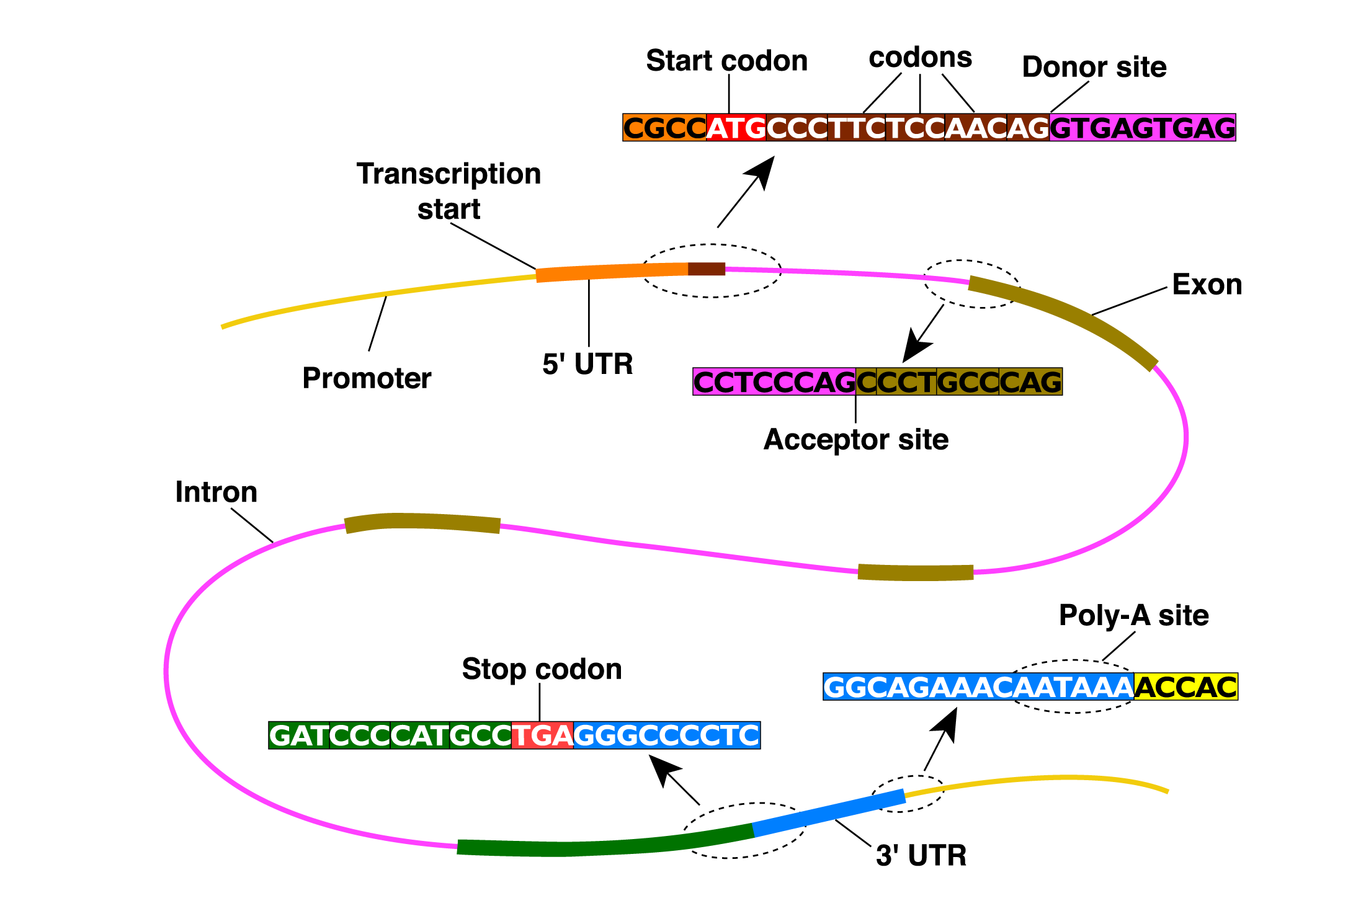
应用II: Gene Finding

Slide 98
Spliced Alignment
Compare with cDNA or EST probes
Start codon
Stop codon
Genomic DNA
Start codon
Stop codon
mRNA
Cap-
-Poly(A)
5’-UTR
3’-UTR

Slide 99
Spliced Alignment
Compare with Protein Probes
Start codon
Stop codon
Genomic DNA
Protein

Slide 100
A Eukaryotic Gene
This is the human p53 tumor suppressor gene on chromosome 17.
Genscan is one of the most popular gene prediction algorithms.

Slide 101
A Eukaryotic Gene
Introns
Final exon
Initial exon
3’ untranslated region
Internal exons
This particular gene lies on the reverse strand.

Slide 102
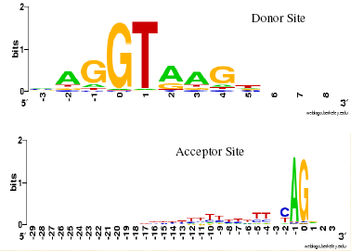
An Intron
revcomp(CT)=AG
GT: signals start of intron
AG: signals end of intron
revcomp(AC)=GT
3’ splice site
5’ splice site

Slide 103
Signals vs Contents
In gene finding, a small pattern within the genomic DNA is referred to as a signal, whereas a region of genomic DNA is a content.
Examples of signals: splice sites, starts and ends of transcription or translation, branch points, transcription factor binding sites
Examples of contents: exons, introns, UTRs, promoter regions

Slide 104
Prior Knowledge
The translated region must have a length that is a multiple of 3.
Some codons are more common than others.
Exons are usually shorter than introns.
The translated region begins with a start signal and ends with a stop codon.
5’ splice sites (exon to intron) are usually GT;
3’ splice sites (intron to exon) are usually AG.
The distribution of nucleotides and dinucleotides is usually different in introns and exons.

Slide 105
Prior Knowledge
We want to build a probabilistic model of a gene that incorporates our prior knowledge.
E.g., the translated region must have a length that is a multiple of 3.

Slide 106
Prokaryotic Vs. Eukaryotic Gene Finding
Prokaryotes:
small genomes 0.5 – 10·10⁶ bp
high coding density (>90%)
no introns
Gene identification relatively easy, with success rate ~ 99%
Problems:
overlapping ORFs
short genes
finding TSS and promoters
Eukaryotes:
large genomes 10⁷ – 10¹⁰ bp
low coding density (<50%)
intron/exon structure
Gene identification a complex problem, gene level accuracy ~50%
Problems:
many

Slide 107
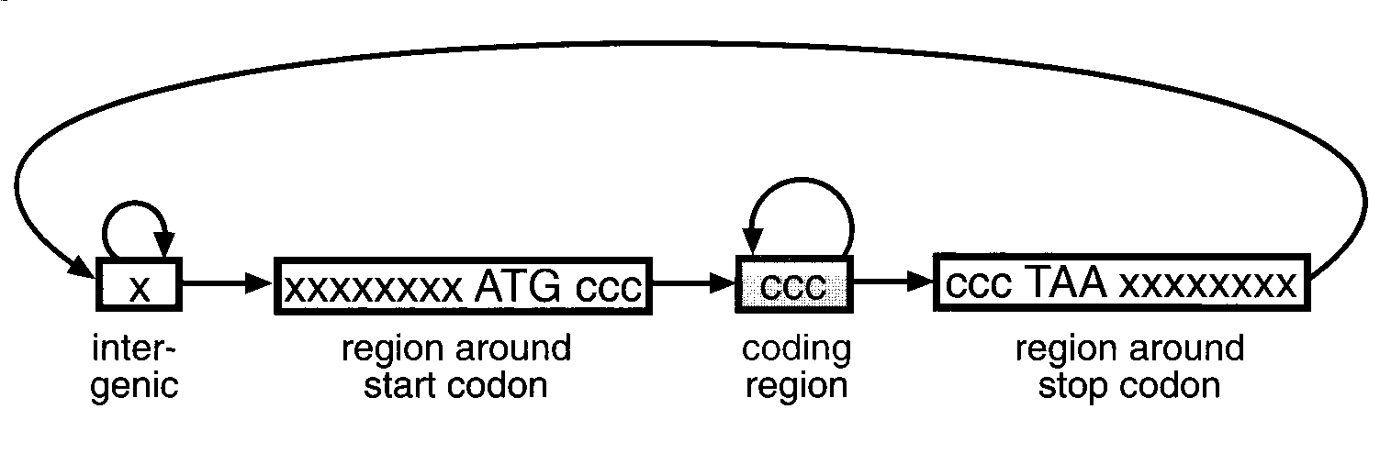
HMMs and Gene Structure
Nucleotides {A,C,G,T} are the observables
Different states generates generate nucleotides at different frequencies
A simple HMM for unspliced genes:
AAAGC ATG CAT TTA ACG AGA GCA CAA GGG CTC TAA TGCCG
The sequence of states is an annotation of the generated string – each nucleotide is generated in intergenic, start/stop, coding state
Notes:
This HMM has 4 states: x- non-coding, c- coding, start and stop

Slide 108
Examples of Gene Finders Using HMM
GeneMark – HMMs enhanced with ribosomal binding site recognition
Genie – neural networks for splicing, HMMs for coding sensors, overall structure modeled by HMM
Genscan – Weight Matrix, Weight Array and decision trees as signal sensors, HMMs for content sensors, overall HMM
HMMgene – HMM trained using conditional maximum likelihood
Morgan – decision trees for exon classification, also Markov Models
VEIL – sub-HMMs each to describe a different bit of the sequence, overall HMM

Slide 109
EXAMPLE: Finding Genes with VEIL
The Viterbi Exon-Intron Locator (VEIL) was developed by John Henderson, Steven Salzberg, and Ken Fasman at Johns Hopkins University.
Gene finder with a modular structure:
Uses a HMM which is made up of sub-HMMs each to describe a different bit of the sequence: upstream noncoding DNA, exon, intron, …
Uses biological knowledge to “hardwire” part of HMM, eg. start + stop codons, splice sites.

Slide 110
The Overall Model of VEIL
Start codon
Stop codon
Downstream
Upstream
Exon
3’ splice site
intron
5’ splice site
5’ polyA site
For more details, see J. Henderson, S.L. Salzberg, and K. Fasman (1997) Journal of Computational Biology 4:2, 127-141.

Slide 111
Genscan
Developed by Chris Burge 1997
One of the most accurate ab initio programs
Uses explicit state duration HMM (semi-HMM) to model gene structure (different length distributions for exons)
Different model parameters for regions with different GC content
Notes:
Also generalized

Slide 112
E₀
E₁
E₂
I₀
I₁
I₂
E_{init}
E_{term}
5’ UTR
3’ UTR
E_{sngl}
polyA
forward strand
P
N
backward strand
P
polyA
5’ UTR
E_{sngl}
3’ UTR
E_{init}
E_{term}
I₀
I₁
I₂
E₀
E₁
E₂

Slide 113
GeneScan
N - intergenic region
P - promoter
(5’/3’) UTR - 5’/3’ untranslated region
E_{sngl} – single exon (intronless) (translation start -> stop codon)
E_{init} – initial exon (translation start -> donor splice site)
E_{k} – phase k internal exon (acceptor splice site -> donor splice site)
E_{term} – terminal exon (acceptor splice site -> stop codon)
I_{k} – phase k intron: 0 – between codons; 1 – after the first base of a codon; 2 – after the second base of a codon

Slide 114
GeneScan Features
Model both strands at once
Each state may output a string of symbols (according to some probability distribution).
Explicit intron/exon length modeling
Advanced splice site modeling
Parameters learned from annotated genes
Prediction of multiple genes in a sequence (partial or complete).

Slide 115
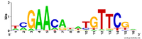
PWM
Position Weight matrix (PWM) for acceptor site, branch point, polyA site and promoter region.
http://en.wikipedia.org/wiki/Position_weight_matrix

Slide 116
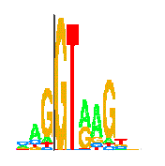
Donor Sites: A Simple Model
Donor site
5’
3’
Position
%

Slide 117
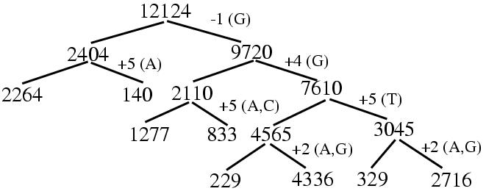
Donor Sites: An Advance Model
MDD (maximal dependence decomposition)
Nodes: Counts
Edges: Split Variables

Slide 118
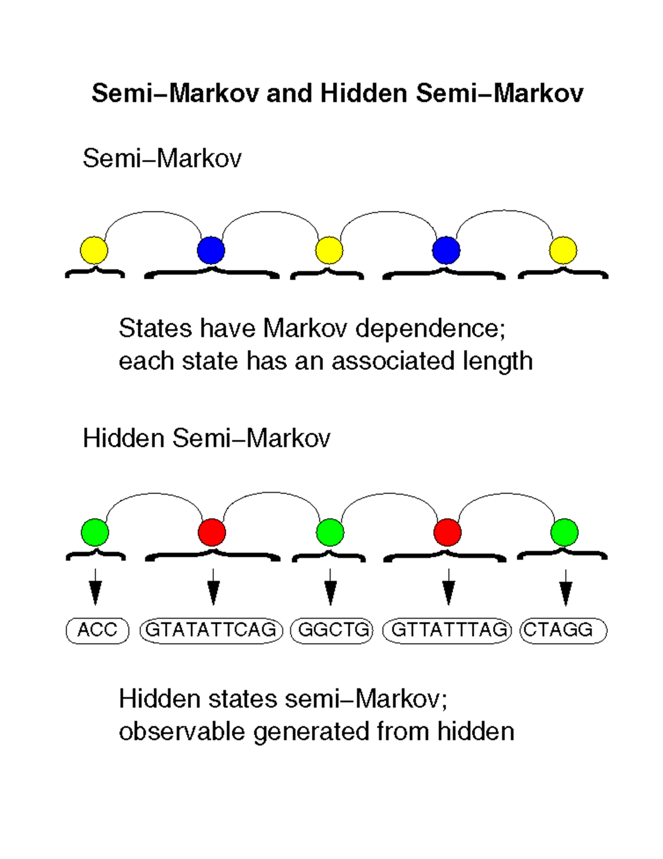

Slide 119
Why Semi-Markov Model
For general Markov model, the duration of state follows a geometric distribution
However, the exon length generally follows a normal distribution

Slide 120
GeneScan
For more detail, see:
Burge, C. and Karlin, S. (1997) Prediction of complete gene structures in human genomic DNA. J. Mol. Biol. 268, 78-94
Burge, C. B. and Karlin, S. (1998) Finding the genes in genomic DNA. Curr. Opin. Struct. Biol. 8, 346-354.

Slide 121
参考文献
钱敏平，龚光鲁。《应用随机过程》，北京大学出版社，1998。
David W. Mount. Bioinformatics, Sequence and Genome Analysis. Cold Spring Harbor Laboratory Press, 2002.
Amy N. Langville and Carl D. Meyer. Deeper Inside PageRank, Internet Mathematics Vol. 1, No. 3: 335-380, 2004.
L. Rabiner, “A Tutorial on Hidden Markov Models and Selected Applications in Speech Recognition”, Proceedings of the IEEE, Vol. 77, No. 2, Feb. 1989
On-line tutorial: http://www.comp.leeds.ac.uk/roger/
HiddenMarkovModels/html_dev/main.html

